Slide 1

VITA App
Training for Trainers, Site Coordinators, and Volunteers

Slide 2
Why an App?
Improve client experience
Reduced wait times
Provide feedback
Improve volunteer experience
Go where they are most needed
Provide suggestions
How:
Client: Visibility to sites and support options (MFT, Express, etc.)
Focus volunteers on sites that need and can use help
Site Coordinators are key: they must maintain the site calendar and eFiler requirements for their site to guide volunteers

Slide 3
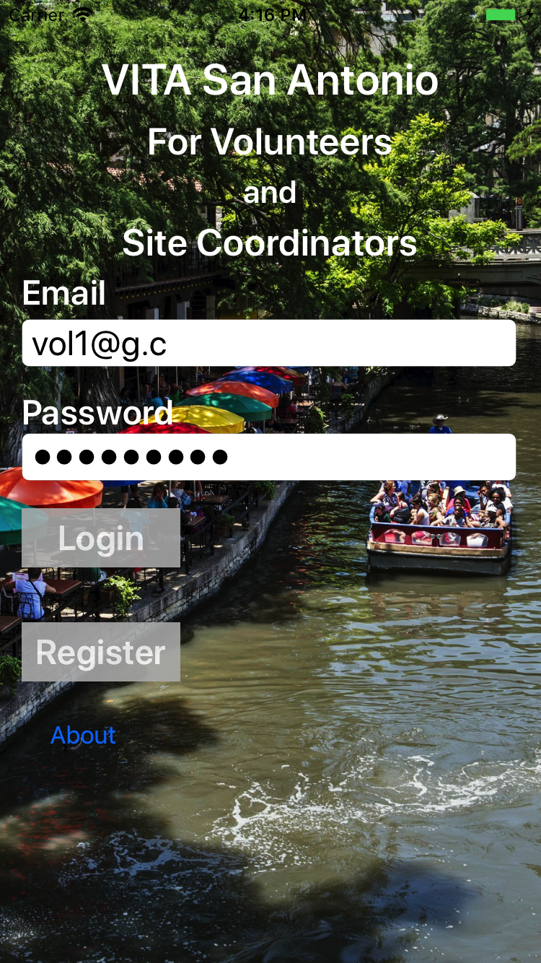
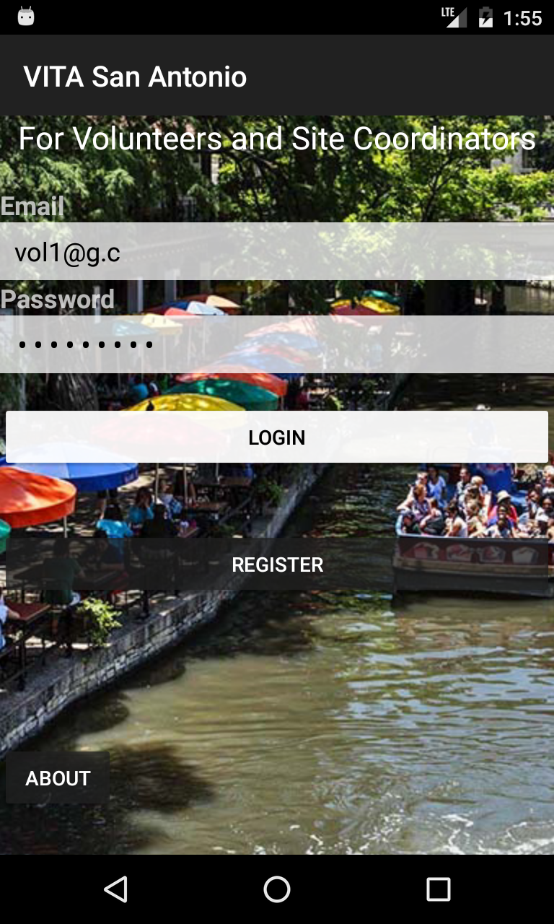
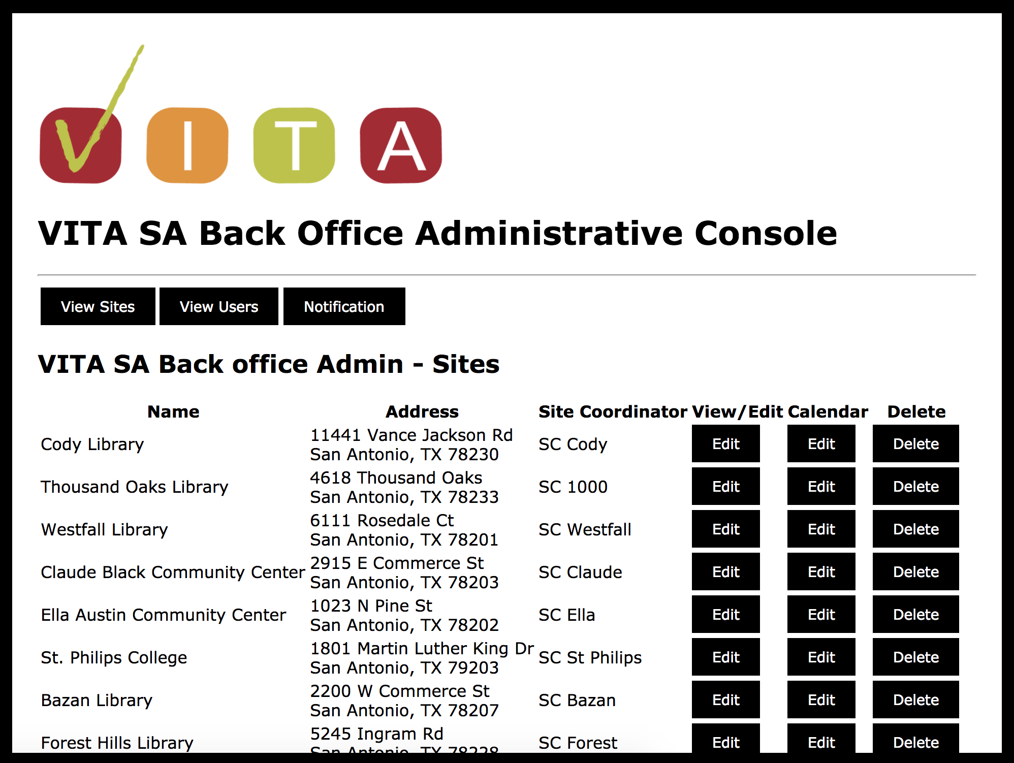
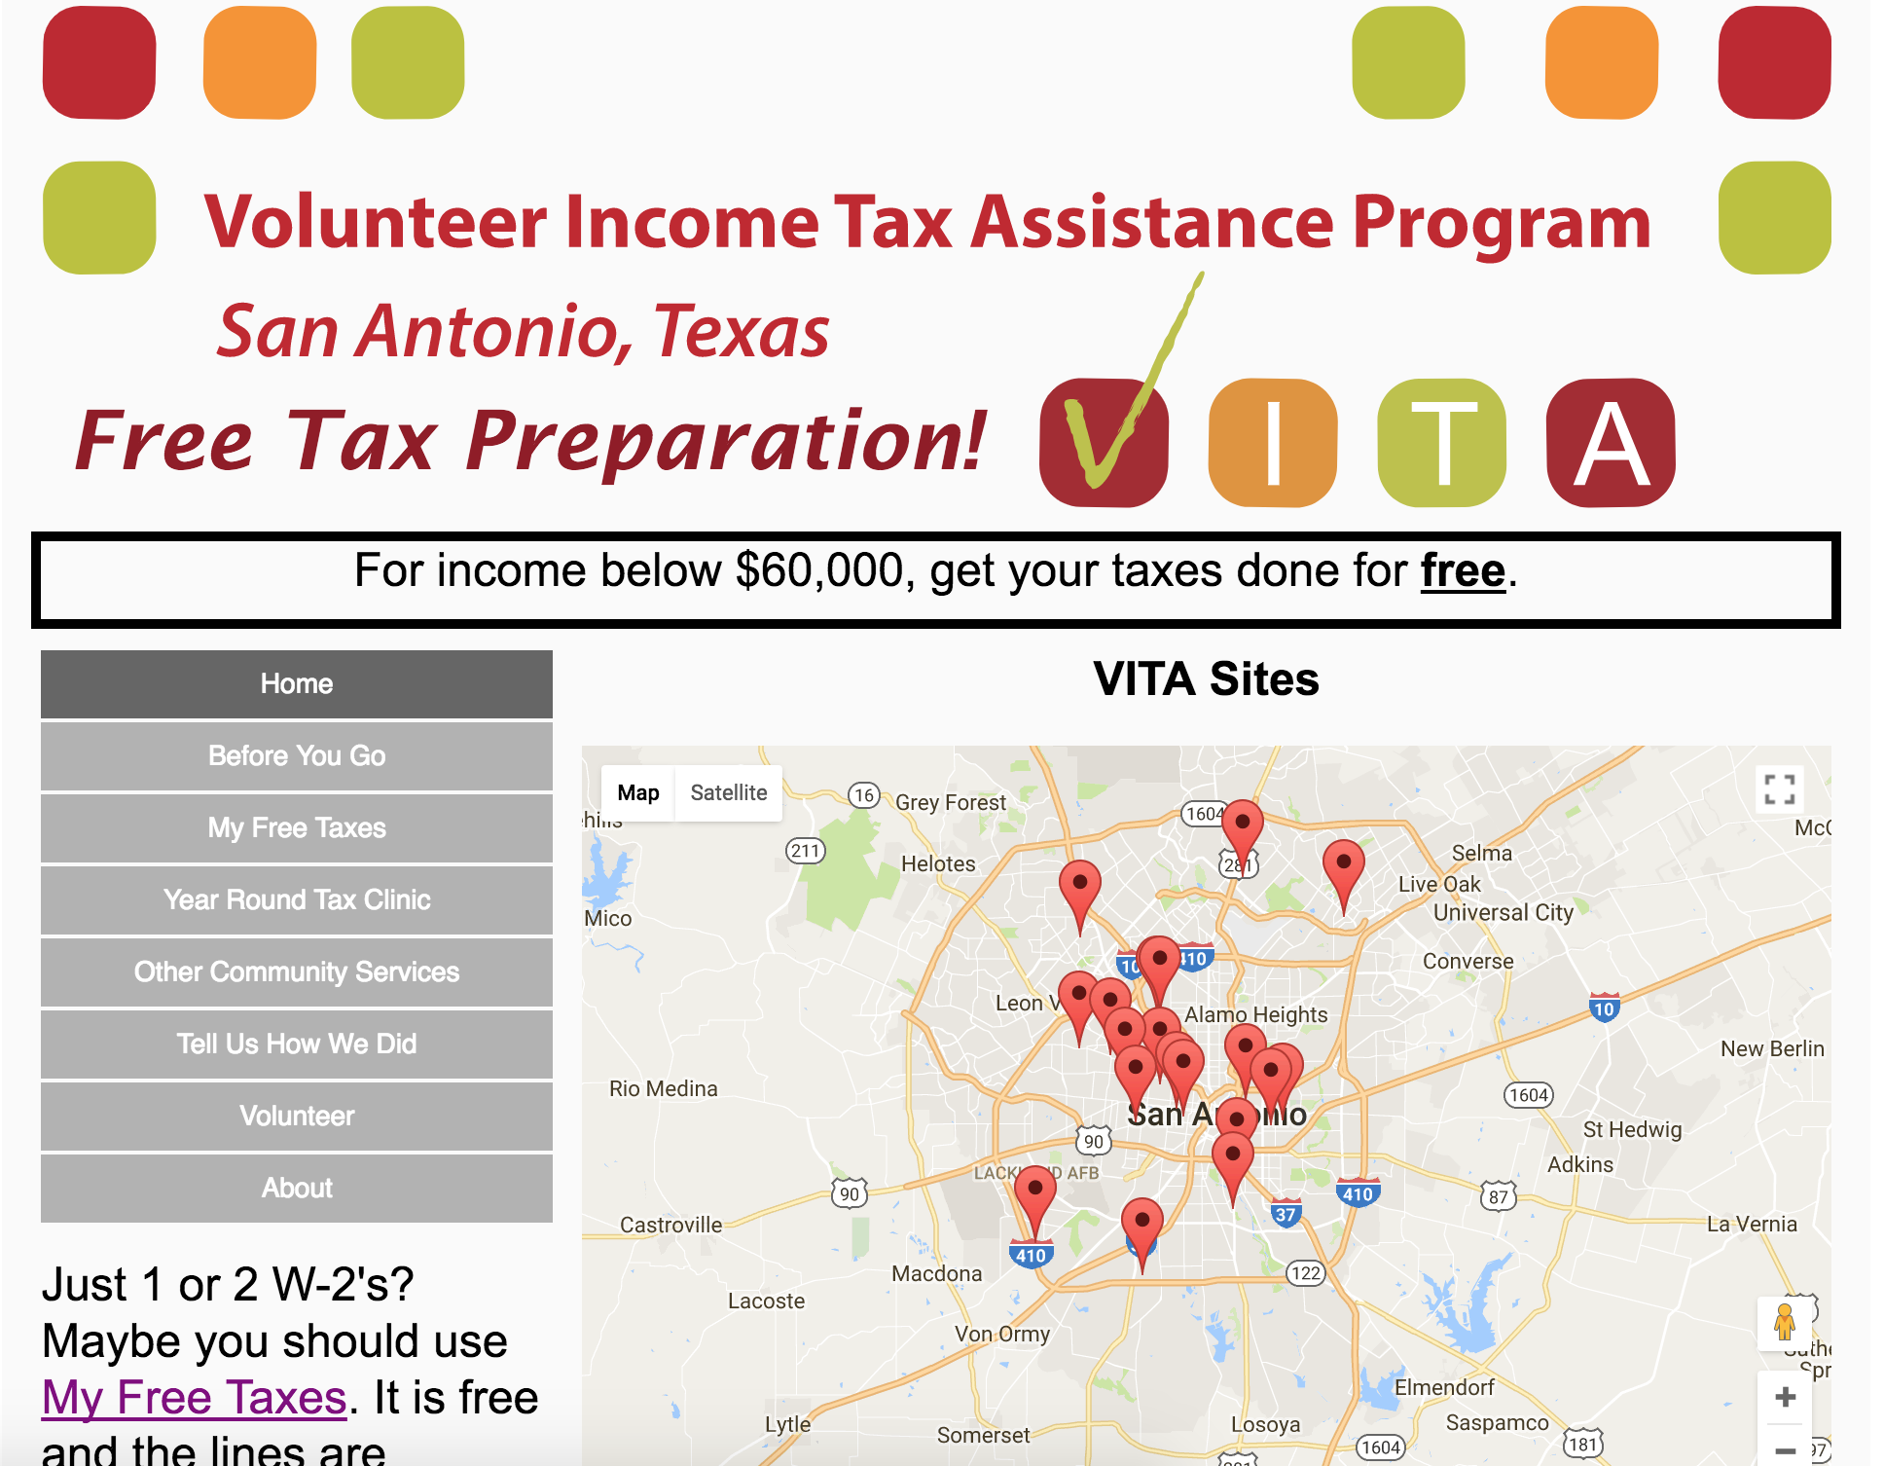
VITA App and Website
BackEnd
DB
iOS Devices
Android Devices
vitasa.org
(English and Spanish)
Back office administration
Client web and mobile

Slide 4
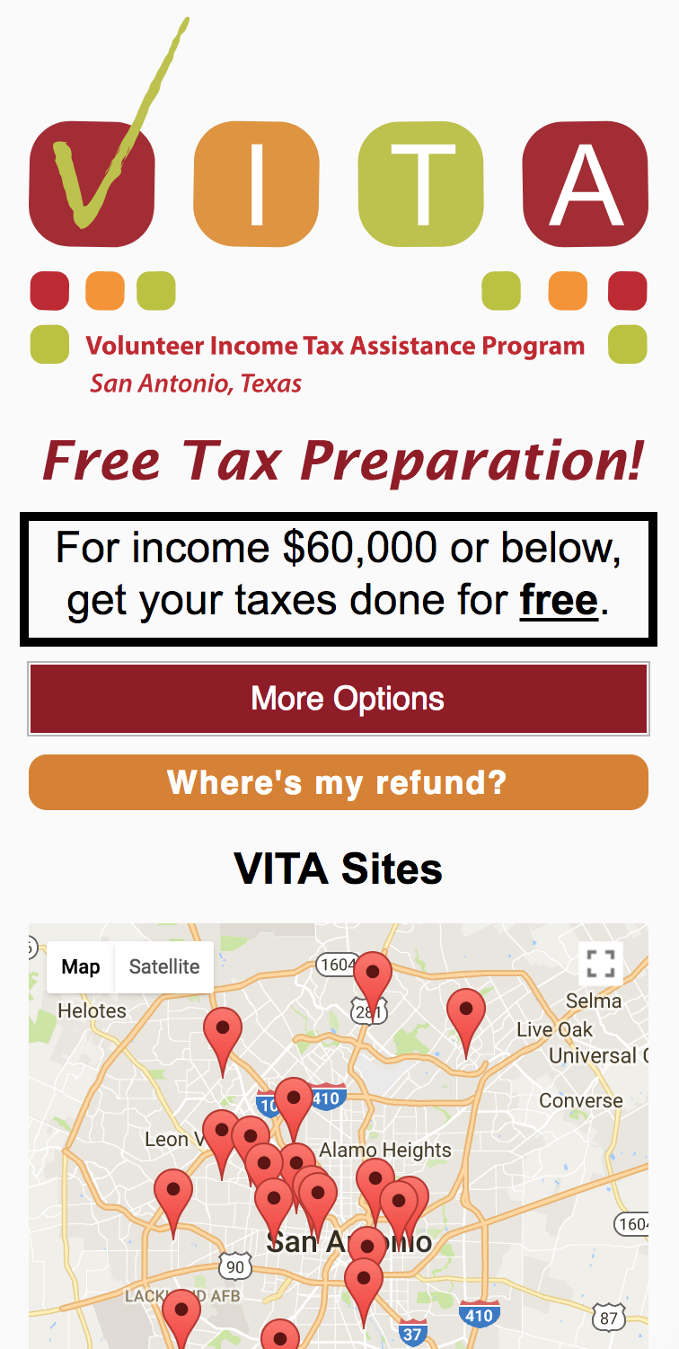
vitasa.org - Clients
Try it out: vitasa.org/en
Home page: map of sites and guidance on what to bring
Info on VITA
List of VITA sites address, and services
My Free Taxes: map and instructions
Year Around Tax Clinic: locations and services
Community services: list and services
Client feedback form
Contact Us: Alejandra and Sheila
Volunteers: why and how to volunteer
(Spanish and English)

Slide 5
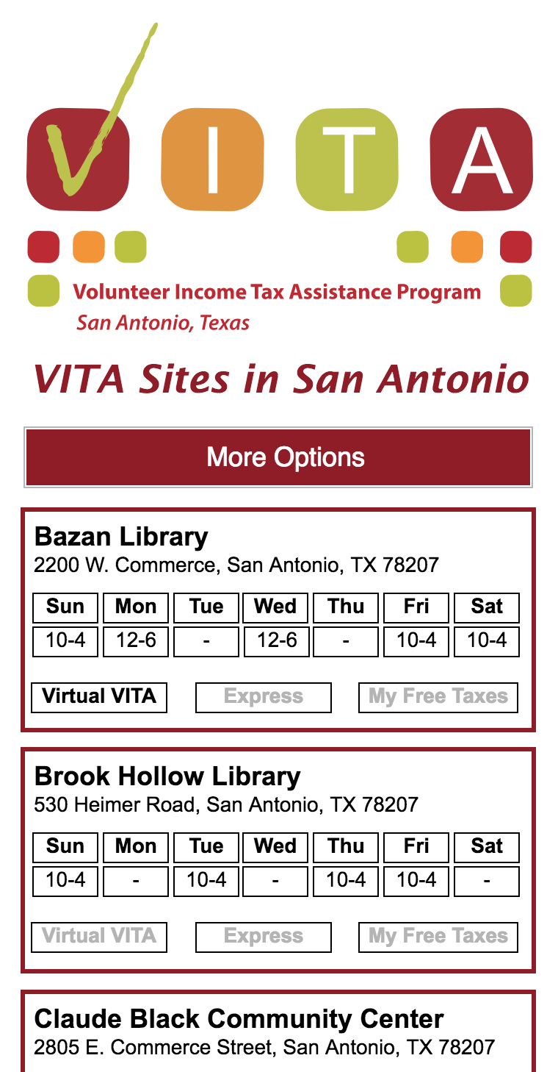
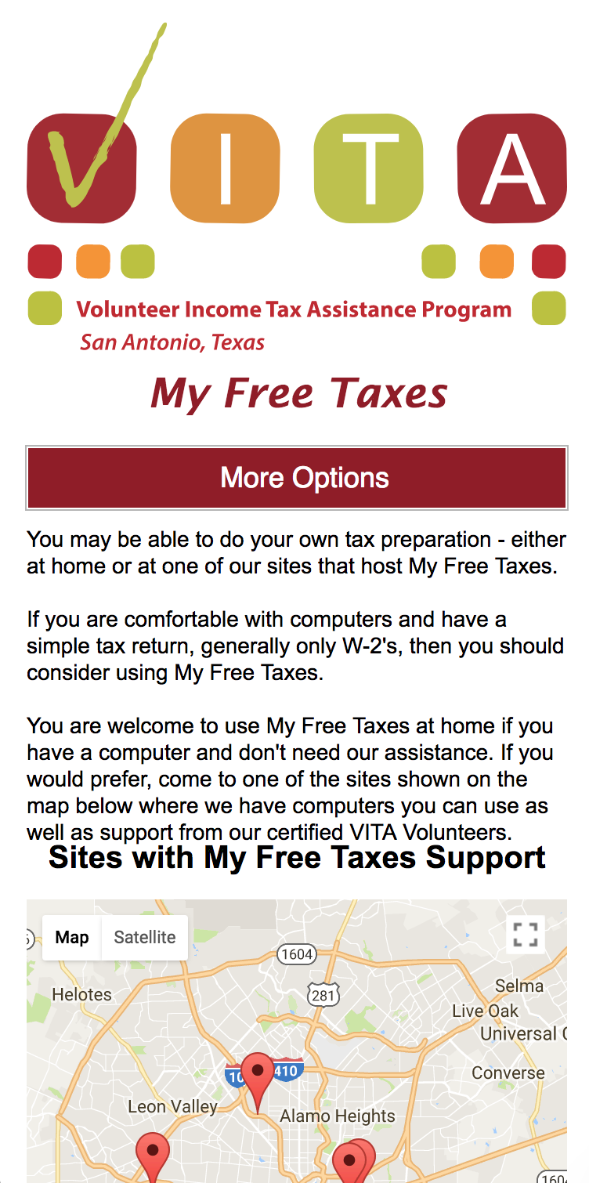

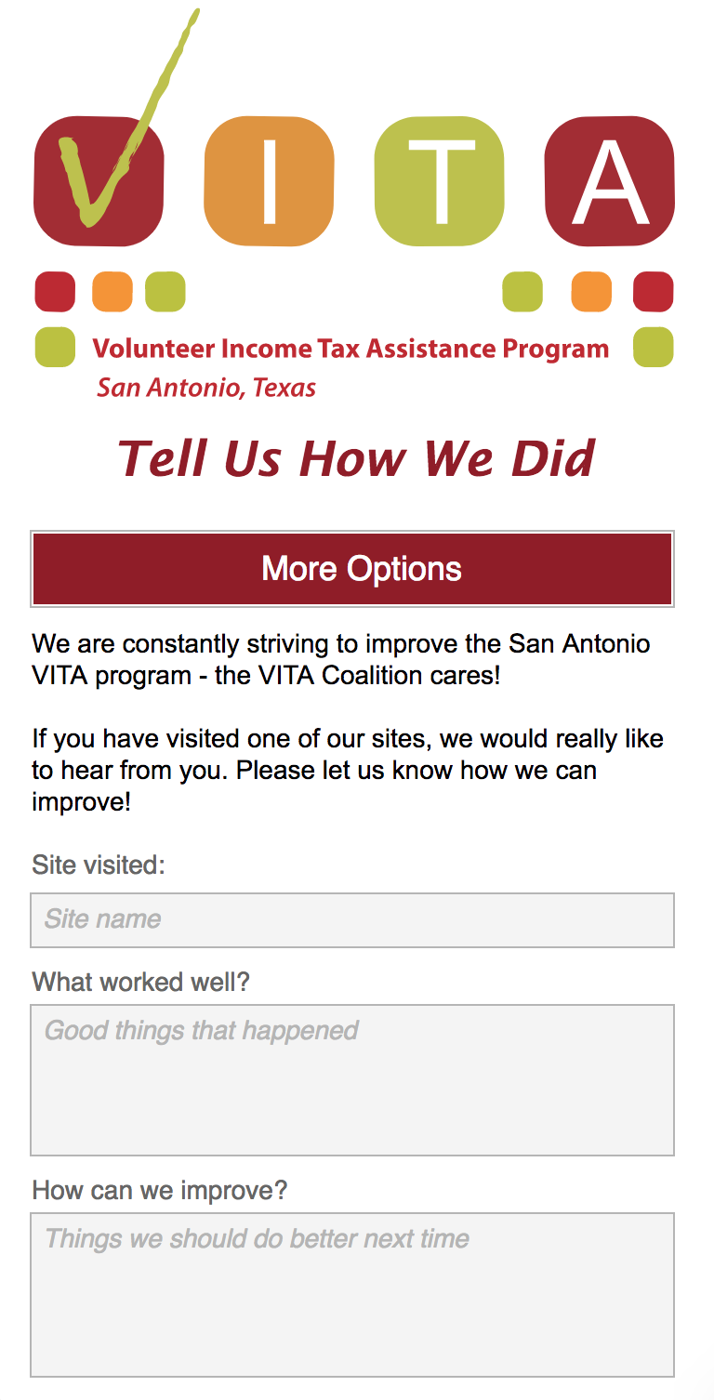
vitasa.org - Clients
Try it out: vitasa.org/en

Slide 6
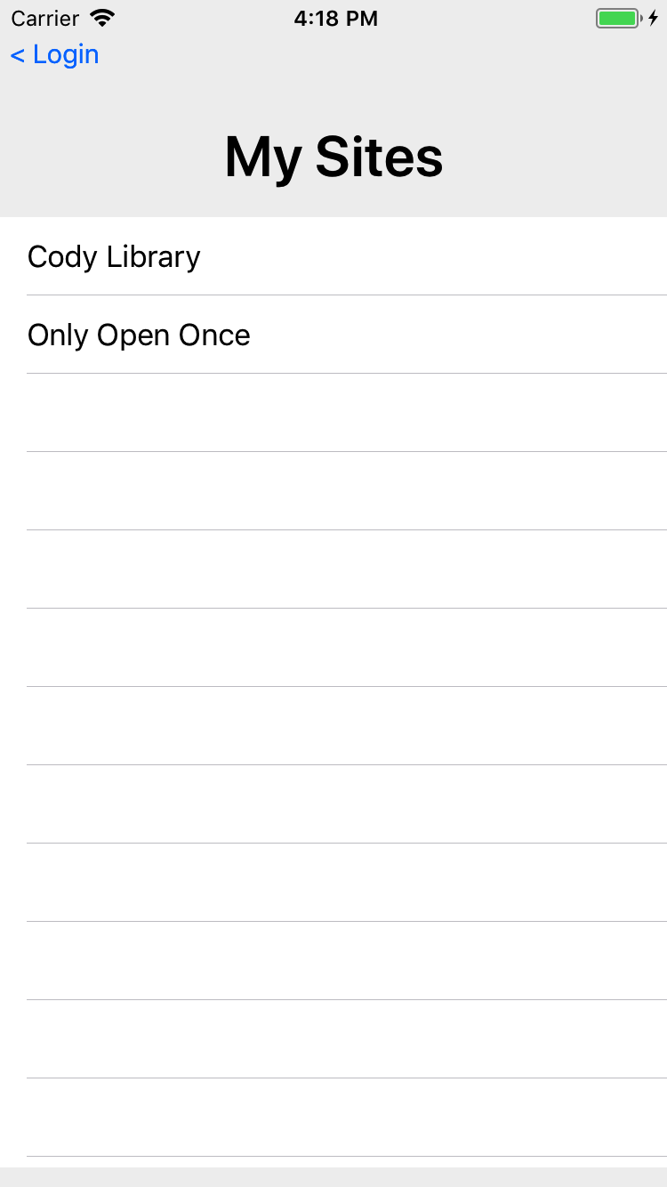
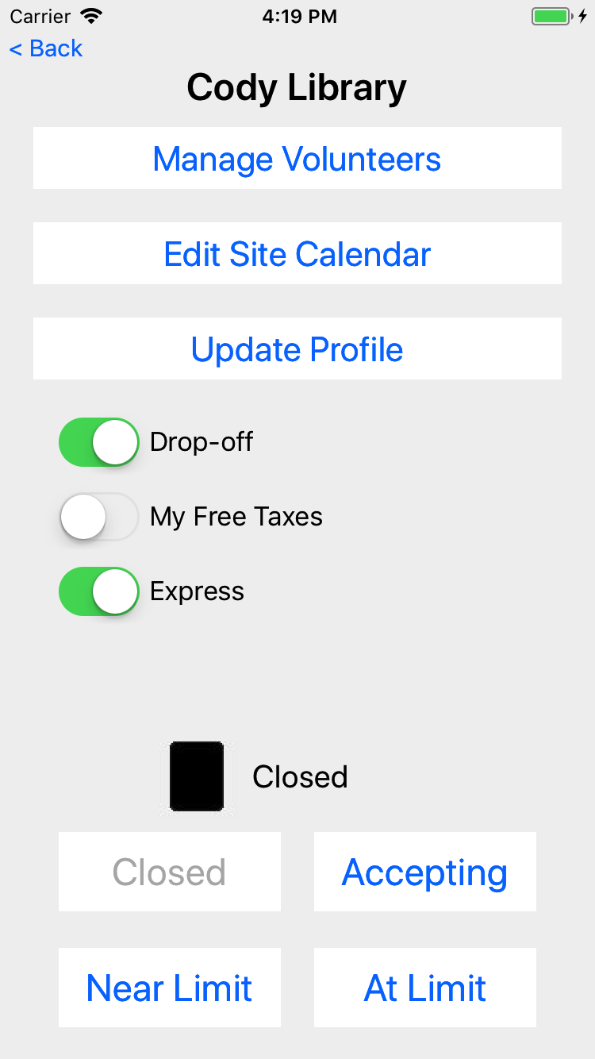
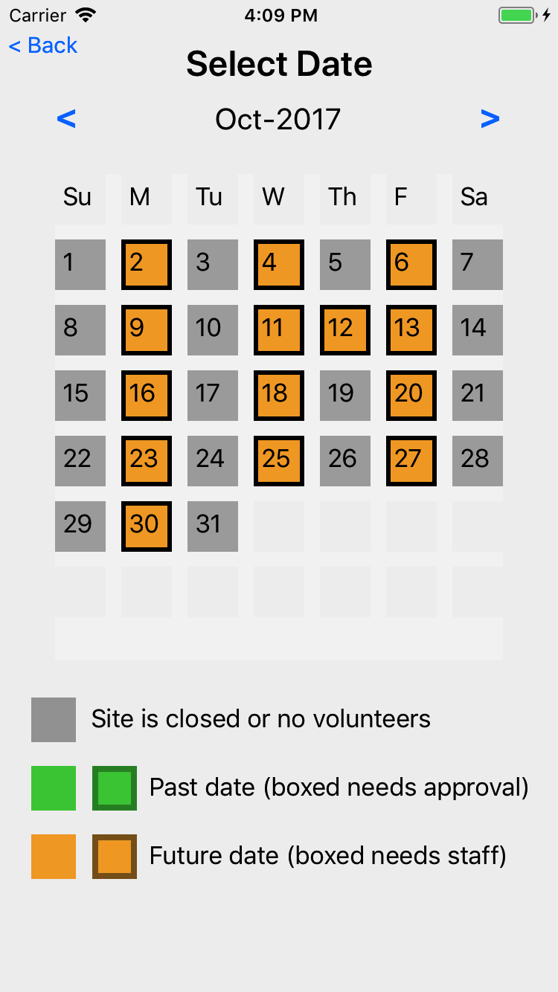
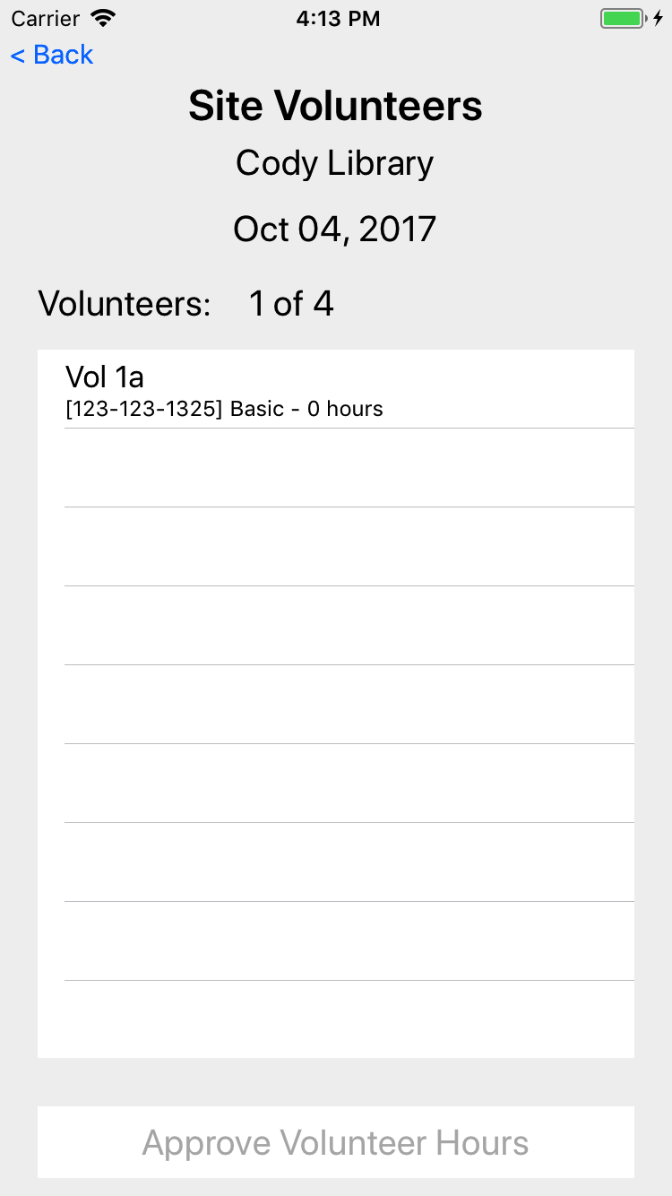
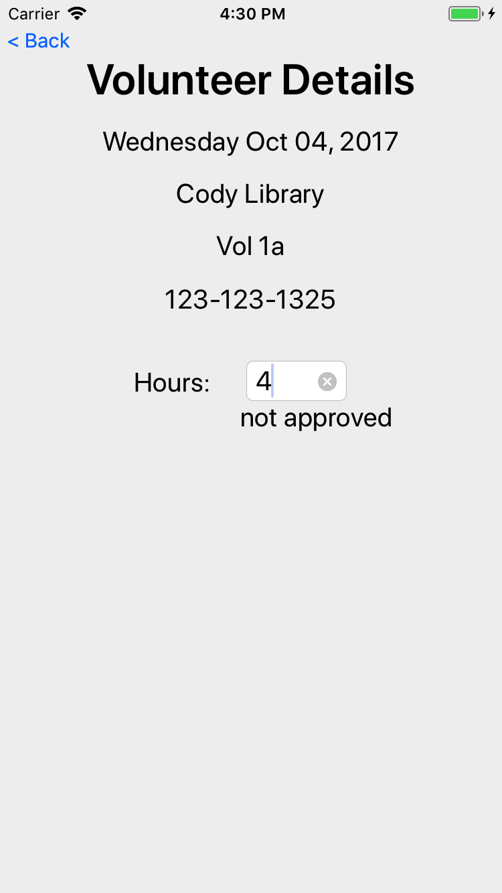
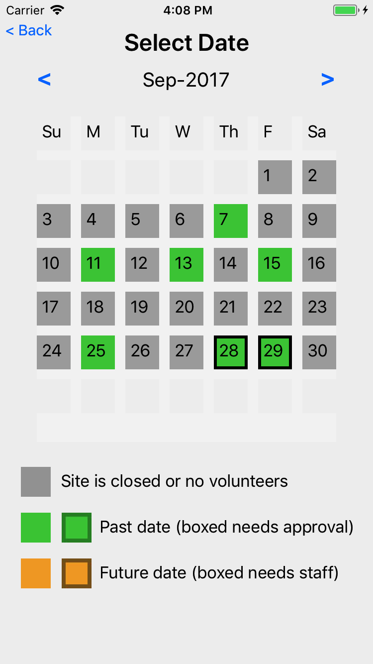
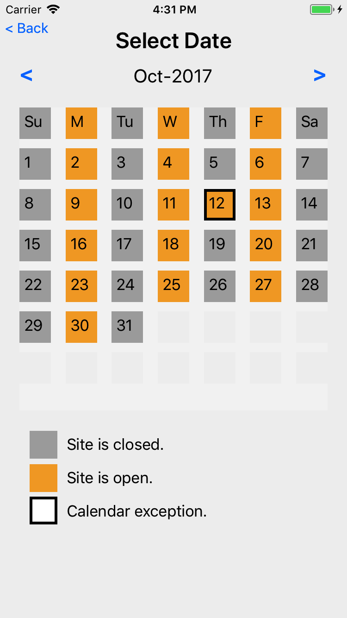
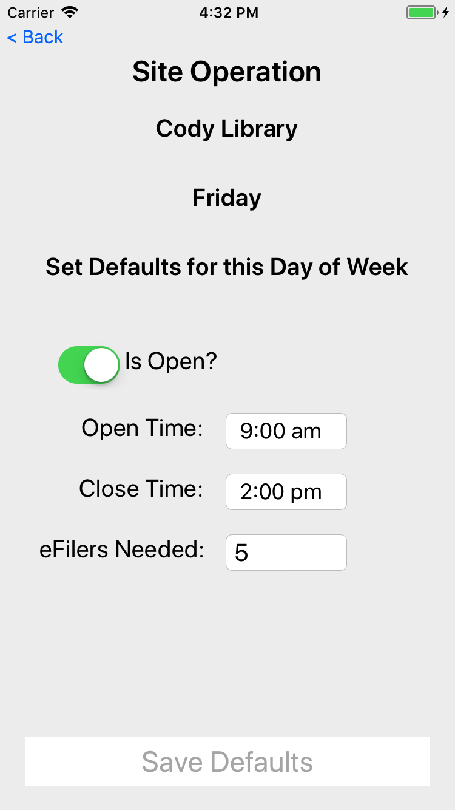
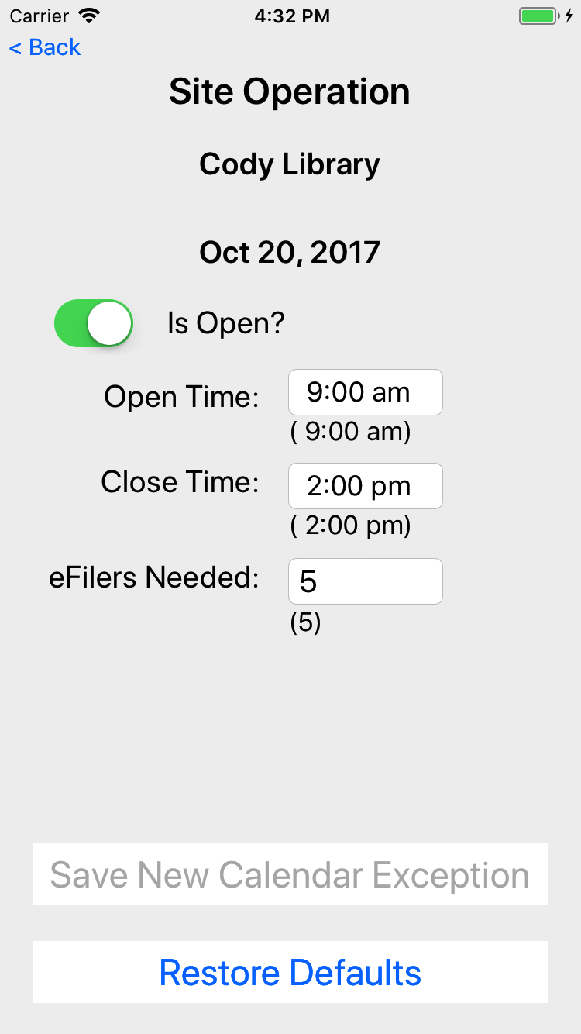
VITA App – Site Coordinators
Select Site
Manage Site
Site Volunteers
Site Calendar

Slide 7
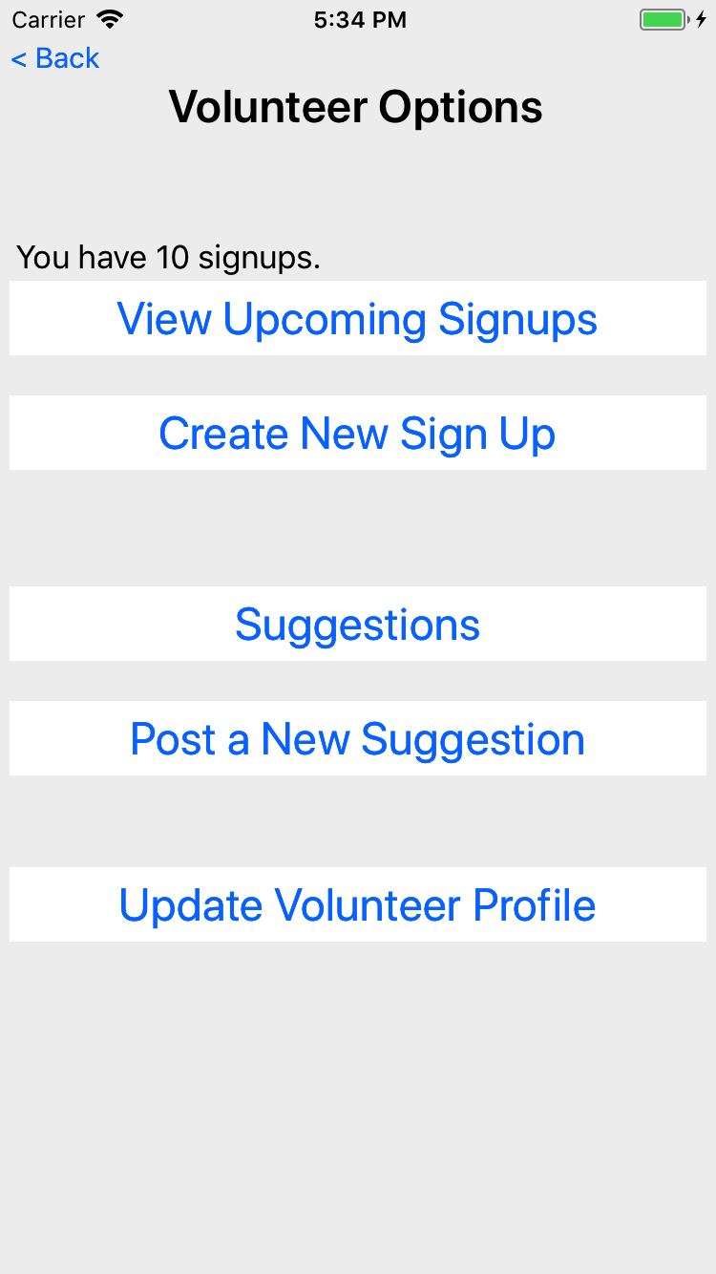
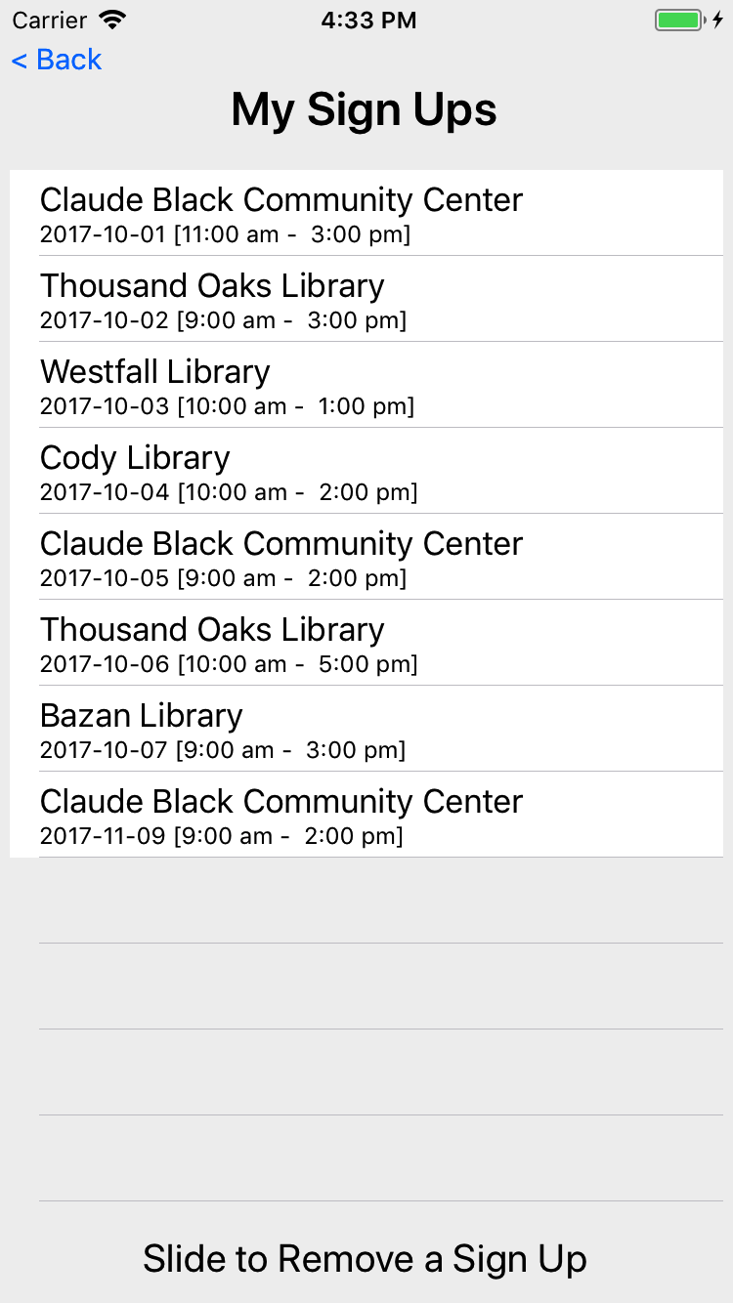
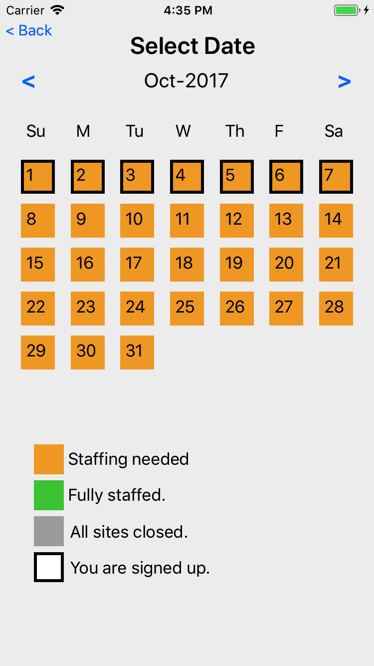
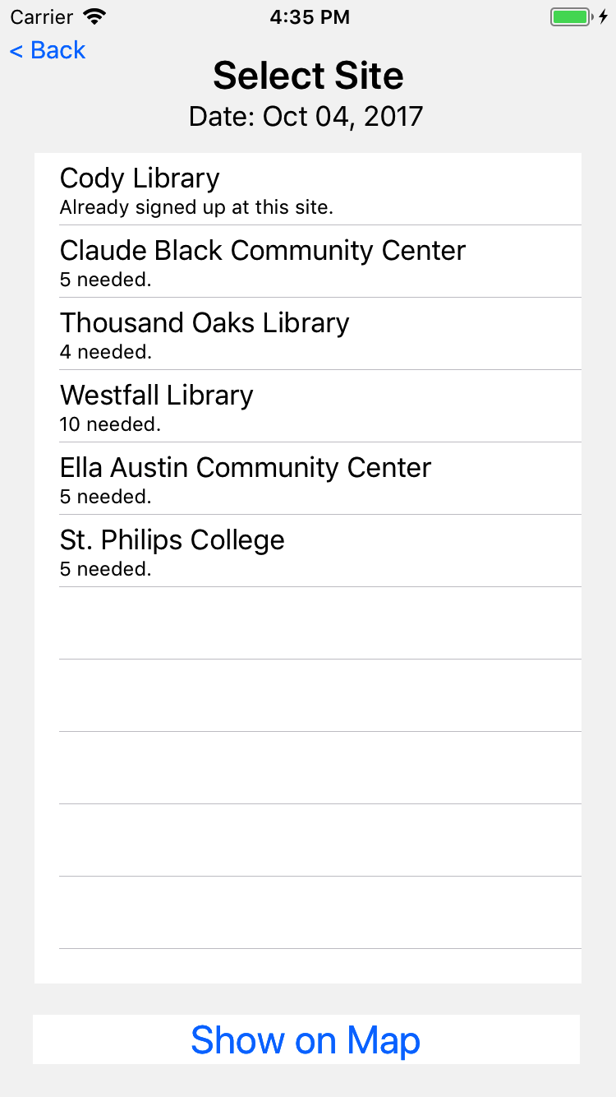
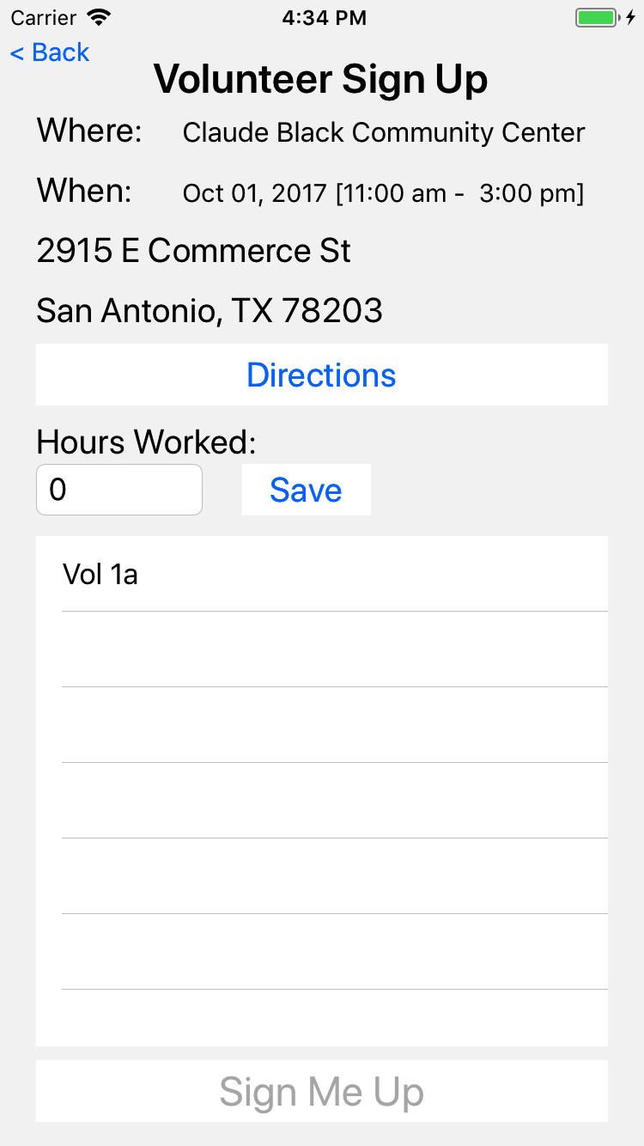
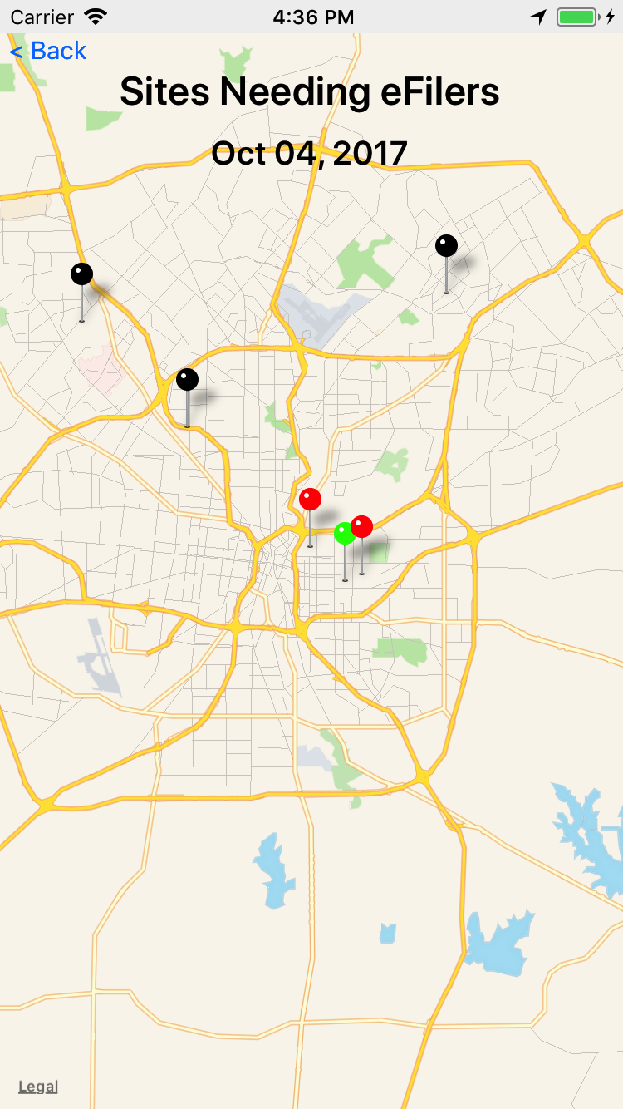
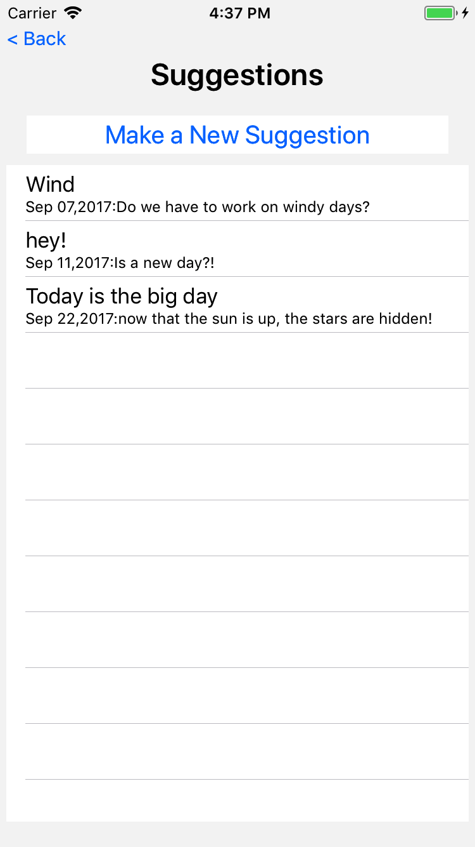
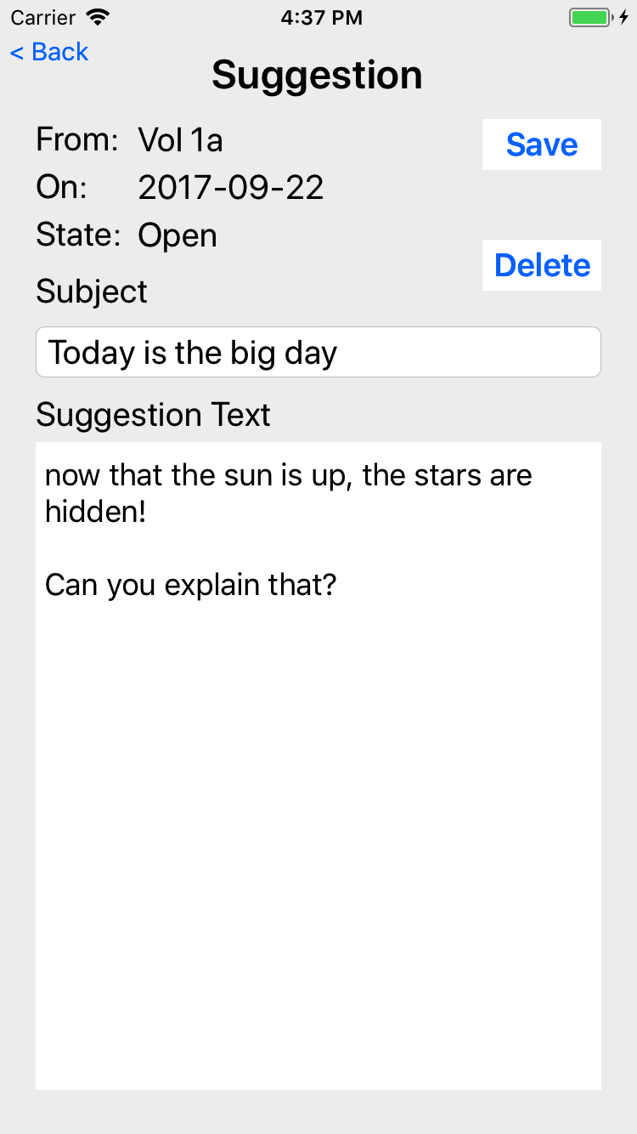
VITA App – Volunteers
Signups
Select Date
View/Confirm
Select Site
Suggestions

Slide 8
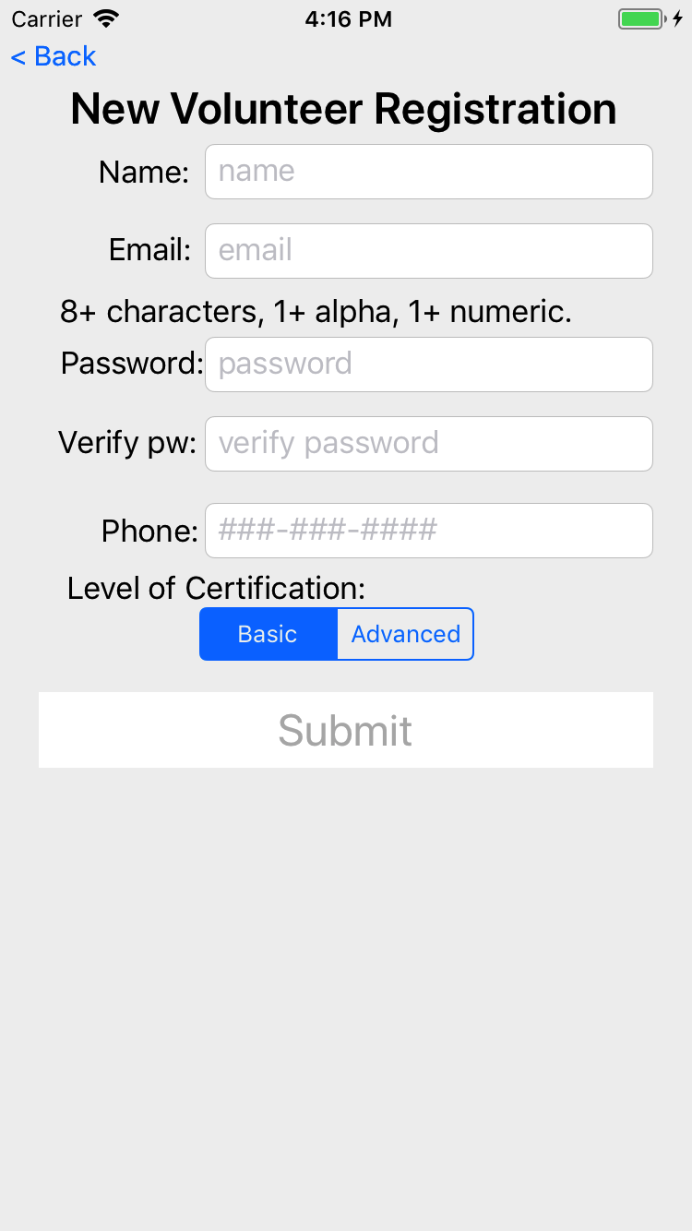
Everyone must register
Back office staff must review and approve

Slide 9
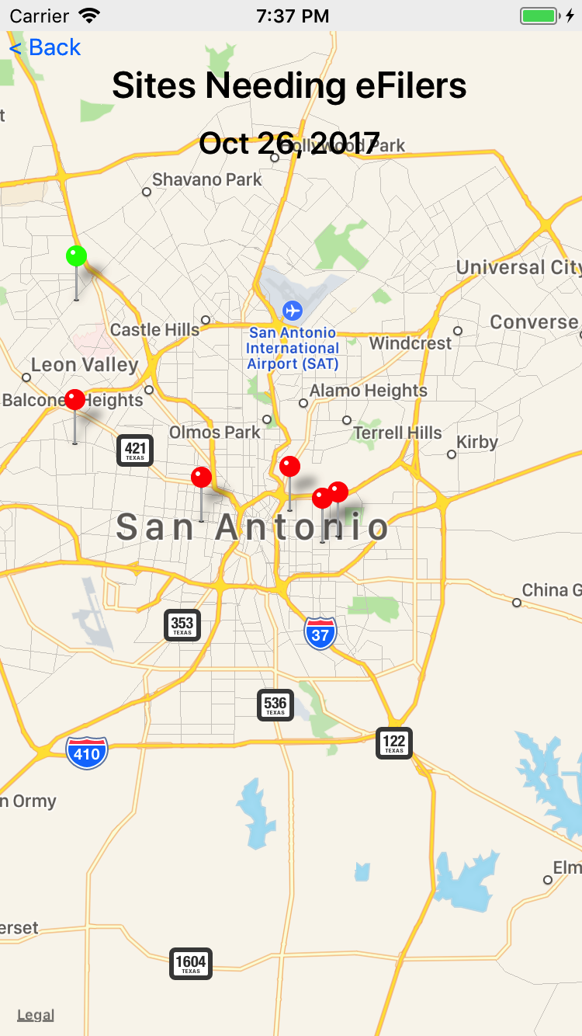
VITA SA App
Volunteer Management
For iPhone and Android phones
Encourage volunteers to go to the sites that need help.
(and away from sites that don’t)
Encourage clients to use the web and provide feedback.
Optimize the customer experience by fully utilizing staff, sites, and volunteers.

Slide 10
Actions
Site Coordinators
Maintain site calendar and services
Set number of desired eFilers for each date
Approve eFiler hours
Volunteers
Signup to volunteer at a site on a date
Get reminders via calendar

Slide 12
New volunteer registration
Once back office staff approves the user, they can login to the app.

Slide 13
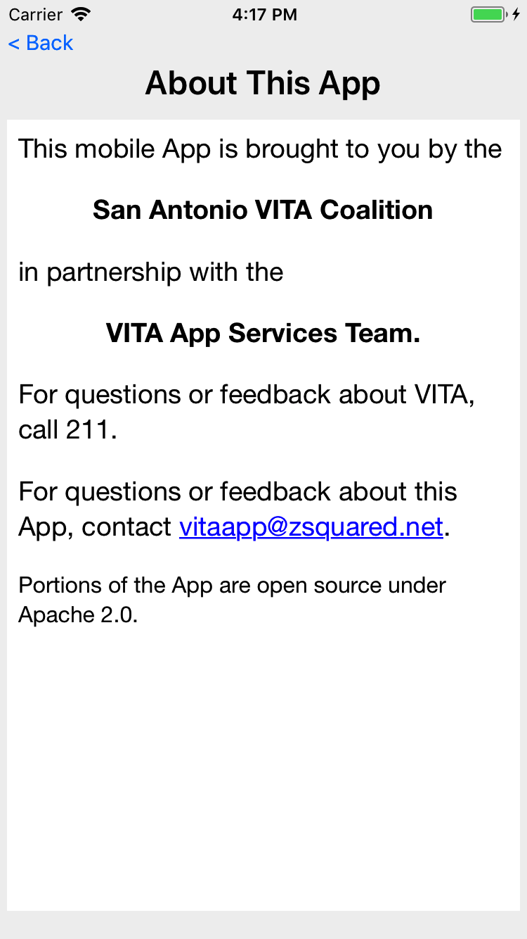
Information about the app.

Slide 14
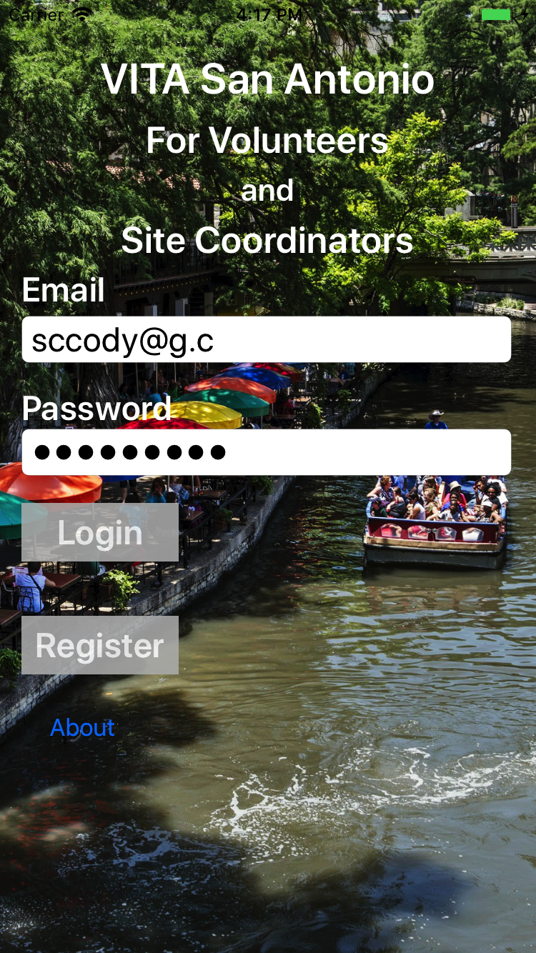
Site Coordinator login

Slide 15
If a Site Coordinator is a primary or backup on more than one site, this screen is shown to determine which site they wish to manage.

Slide 16
Managing the details for a Site

Slide 17
Get a view of volunteers at the site
Green are past dates, boxed for when their hours need approval.
Orange are future dates, boxed when the needed number of eFilers is less than the number signed up.

Slide 18
Manage Site Volunteers
See the volunteers for the date
See phone, cert level, and hours
SC can then approve hours for today and past dates

Slide 19
When a user is touched, the SC can adjust the hours (whether approved or not)

Slide 20
Managing the details for a Site

Slide 21
Edit Site Calendar
Touching on top row manages the defaults schedule for each day of the week
Touching a day of week allows edit/change/remove a calendar exception
The open/close for a Site is determined by starting with the defaults, then looking for an exception; if exception found, use the exception

Slide 22
Edit site calendar defaults for each day of the week, Friday as shown here

Slide 23
Screen to edit/remove an exception for a given date

Slide 24

Volunteer login

Slide 25
Volunteer options

Slide 26
The list of signups for the volunteer, for today and moving forward.
Historical signups are not visible to the volunteer (only the site coordinator)

Slide 27
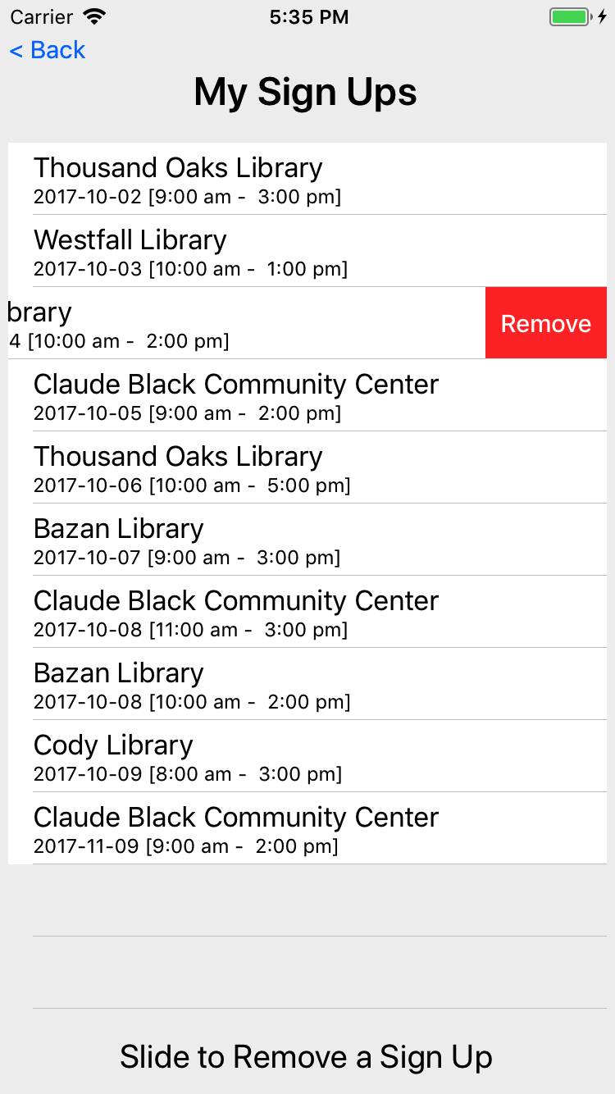

Slide 28
A volunteer can look a their signup, get directions to the site and adjust the hours work.
Hours work can be adjusted by the volunteer until approved by the SC.
The table at the bottom shows other volunteers at the same site on that date.

Slide 29
Volunteer options

Slide 30
To create a new signup, a volunteer first picks a date.

Slide 31
The app then shows sites open on that date that need 1 or more eFilers
If the user happens to be already signed up on that date, that site signup is show.
Mobile team members will be signed up on multiple sites per day.

Slide 32
A map of sites needing eFilers
Black is a closed site
Green is a site that has all seats filled
Red is a site that needs help

Slide 33
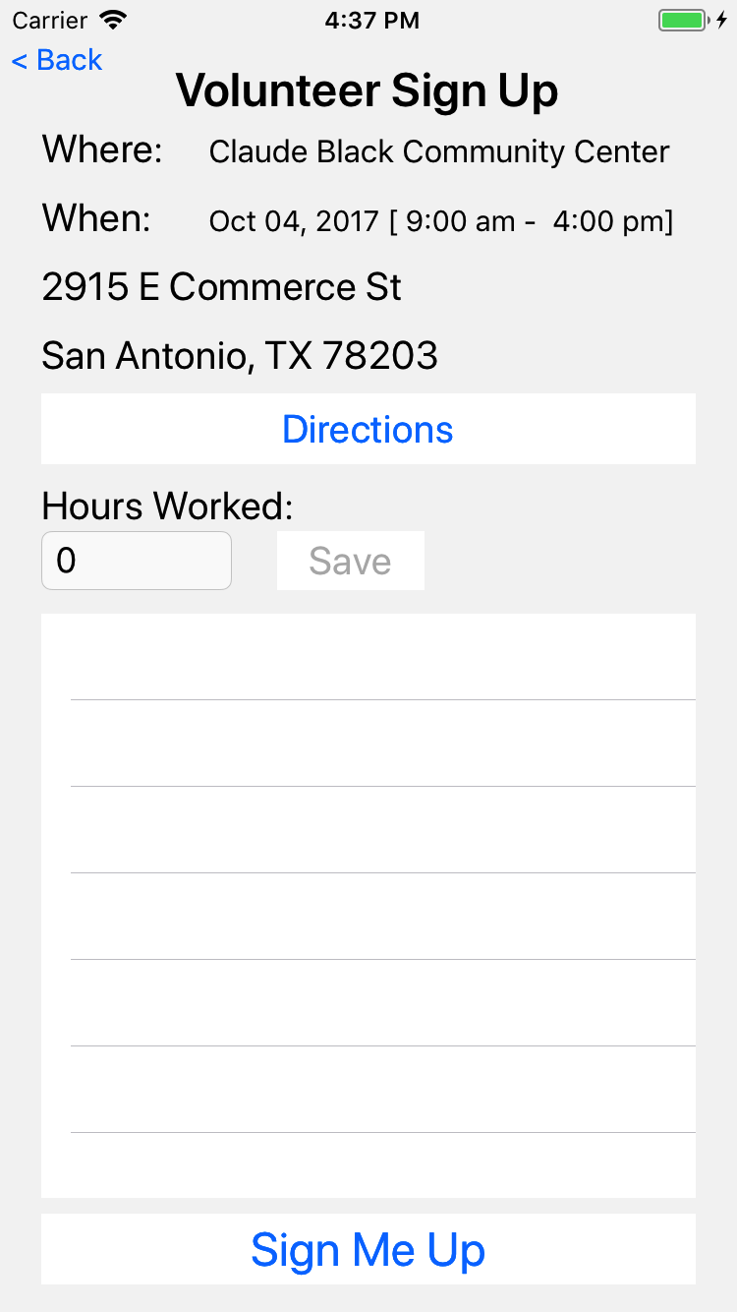
If the volunteer chooses a site, then they get a chance to sign up

Slide 34
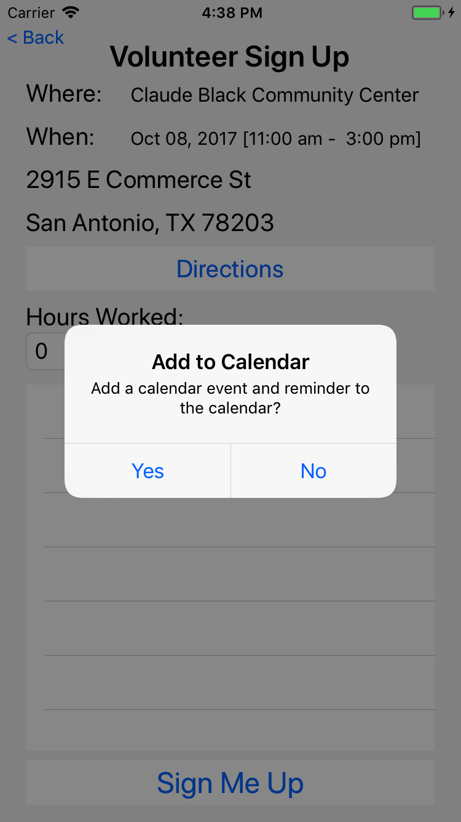
They are given an option to add to their default calendar

Slide 35
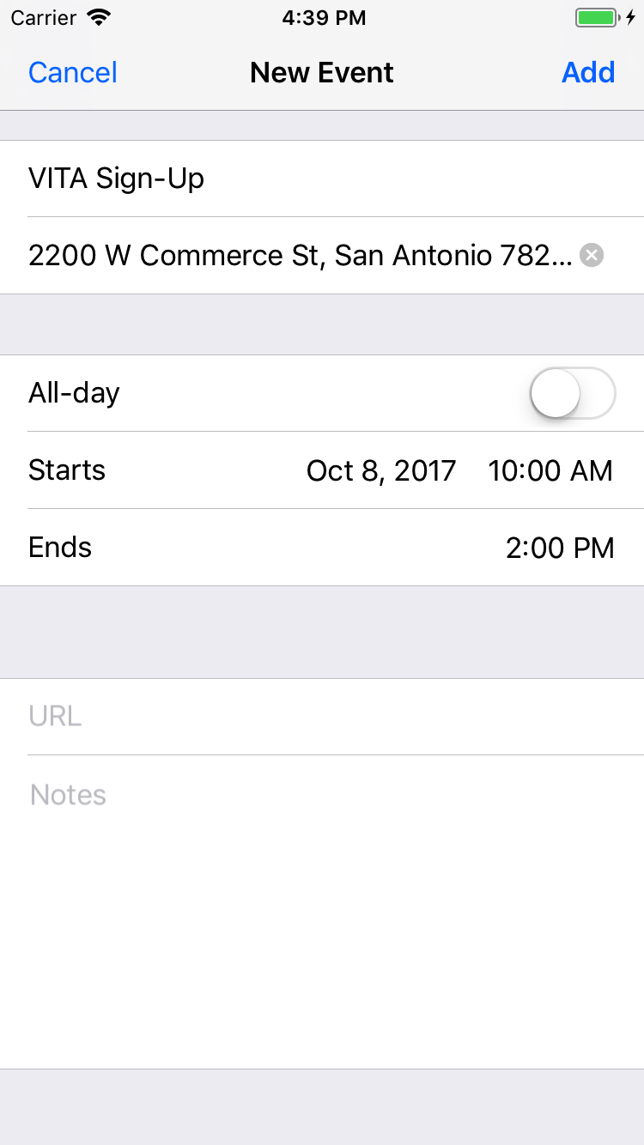
And the ability to modify the calendar event before it is saved in their calendar.

Slide 36
Volunteer options

Slide 37
Volunteers can make suggestions.
Here is a list of suggestions from this user.

Slide 38
Touching a suggestion allows the user (that submitted the suggestion) to view
The user can make changes until the suggestion is read by the committee; after that, the user can only view the suggestion

Slide 39
Volunteer options

Slide 40
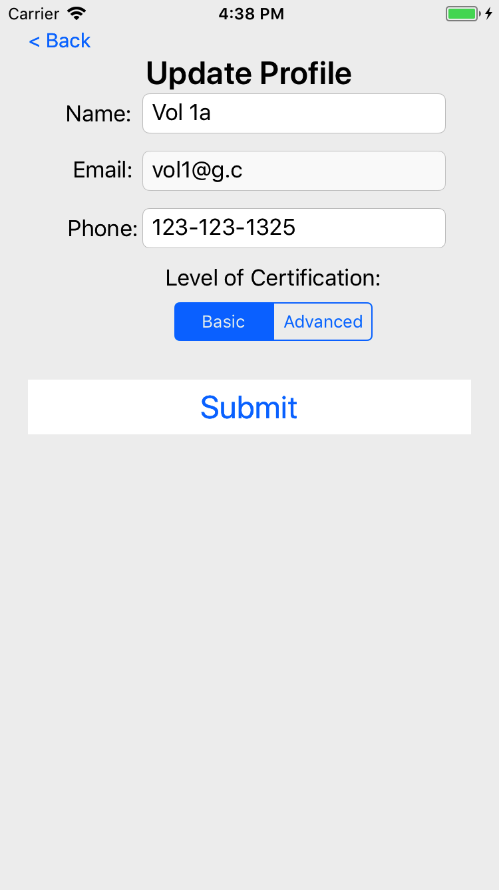
The volunteer can edit their name, phone, and certification but not their email

Slide 41
Not shown
Back office staff can send notifications to volunteers and/or site coordinators

